Slide 1
Anatomy of a Git Project
Victor Grazi – VP DevOps Core Services
Nomura Securities
New York, NY
Notes:
A lot of people are migrating to Git from other version control systems like SVN. And there are differences. Today I don't want to talk about SVN, Github, Gitlab, I just want to talk about Git. Let's see what the main commands are, see what it is doing under the covers, and see how we can manage our projects in Git.

Slide 2
Getting to Know Git
SVN projects:
local workspace
and remote repository.
Git remote & local clones look exactly alike.
git init creates a local Git repo.
Three areas in a Git local repo:
Working area
Staging area (or Index)
Repository
Notes:
If you are from the SVN world, you have a local workspace and a remote repository for each project.
In your local directory, you have a lot of .svn directories.
Git is much different. There is no difference between the structure of the remote machine and your local clones. (Any local git repo can be a remote as well) If you create a git repo on your machine, someone else can access your machine and check out and commit.
You don’t even need a remote at all, you can just use
git init to create a local Git repo
There are three areas in a Git local repo:
Working area
Staging area (or Index)
Repository
There is one HEAD, that points to the branch where your commits and checkouts will occur.
Every local git command either moves data between the areas or moves the current head

Slide 3
Getting to Know Git
HEAD points to the branch where your commits and checkouts will occur.
Git commands either:
Move data between these areas. Or
Move the current head. Or
Run a report
Notes:
There is one HEAD, that points to the branch where your commits and checkouts will occur.
Every local git command either moves data between the areas or moves the current head

Slide 4
Git - Initial setup
Install Git git-scm.com
Optimizations for Git Bash slowness:
https://blog.praveen.science/solution-to-git-bash-is-very-slow-in-windows/
git config --global\ core.preloadindex true
git config --global \
core.fscache true
git config --global gc.auto 256
git config --global --list

Slide 5
Git – Common Left to Right Workflow
Working area | Staging Area | Repository (local) | Remote (origin)
Legend
> git commit – m “message”
# commit staging area to repository
(git commit –a –m “message” is the same as git add, followed by git commit)
-
Untracked
> git init # create a local repository
<< create or edit your files >>
> git add . # copy files to staging area
(git rm --cached <file> # opposite of git add)
Uncommitted
Committed
> git push # push the commit to the remote
Notes:
Once you do an init, you can start versioning anything under that directory. No need for a remote

Slide 6
Git – clone
Working area | Staging Area | Repository (local) | Remote (origin)
Legend
> git clone <<url from host>>
Untracked
-
Uncommitted
# init local repo
# and copy remote to local
Committed
Notes:
Using git clone, an exact replica of the remote machine will appear on your local machine, fully initialized

Slide 7
Git – checkout
Working area | Staging Area | Repository (local) | Remote (origin)
Legend
Untracked
Legend
Uncommitted
Committed
Untracked
> git checkout <branch>
Uncommitted
-
Committed
# copy branch to working area
Notes:
Once you do an init, you can start versioning anything under that directory. No need for a remote

Slide 8
What is a commit?
021e638 Oct 19 12:51 vgrazi: done!
master
HEAD
bf1599d Oct 17 12:49 jjones: almost
master
HEAD
a641e01 Sep 15 12:46 mlamb : stuff
master
HEAD
9aca92f Aug 21 12:42 vgrazi: more
master
HEAD
6e33d1c Aug 17 12:21 ismith: change
master
HEAD
fed59d6 Jul 17 11:45 vgrazi: initial
master
HEAD

Slide 9
What goes into a commit?
Commit crunches
File content
Commit date
Parent references,
Their directory structure
your commit comments
and produces a SHA-1 hash code.

Slide 10
Git - What’s a commit?
A commit consists of:
“Blob” objects for each file in that commit
A ”Tree” object pointing to those blobs,
A “Commit” object that points to that tree

Slide 11
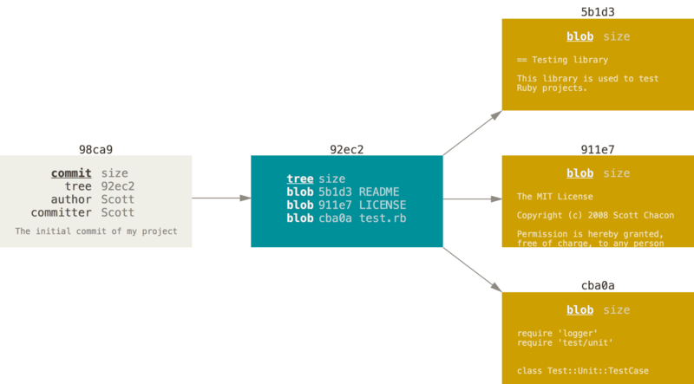
Git - What’s a commit?
$ git cat-file –p 92ec2
tree 1d97b9a335ec
parent 639a1cde8e
author Victor Grazi
committer Victor Grazi

Slide 12
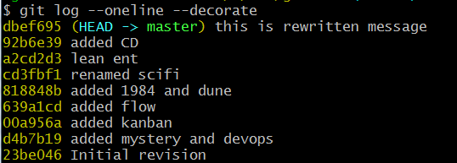
What’s a branch?
A branch is simply a pointer to a commit.
Head points to the current branch
Notes:
because a branch is just a pointer, it is very cheap to create and destroy.
This should encourage developers to do so often
Give your branches a name that include both your JIRA and a brief description

Slide 13
What is a branch?
fe1632
my-branch
HEAD
other
HEAD
932f60a
021e638
my-branch
HEAD
master
HEAD
other
HEAD
a641e01
3f1509d
bf1599d
my-branch
HEAD
master
HEAD
9aca92f
6e33d1c
master
HEAD
de159d6
master
HEAD

Slide 14
Git – Soft Reset
Working area | Staging Area | Repository (local) | Remote (origin)
> git reset --soft <commit# or branch or HEAD>
# moves the HEAD pointer for the current branch # to the specified commit # Does not touch staging or working areas
-
Legend
Untracked
Uncommitted
Committed
Notes:
Once you do an init, you can start versioning anything under that directory. No need for a remote

Slide 15
Git – Mixed reset
Working area | Staging Area | Repository (local) | Remote (origin)
> git reset <commit# or branch or HEAD>
# copy commit to staging but not to working area # issues no warning
# (-- mixed is default)
-
Legend
Untracked
Uncommitted
Committed
Notes:
Once you do an init, you can start versioning anything under that directory. No need for a remote

Slide 16
Git – hard reset
Working area | Staging Area | Repository (local) | Remote (origin)
Legend
Untracked
> git reset --hard <commit# or branch or HEAD>
Uncommitted
Committed
> # copy the commit to staging and
> # working areas, and moves > # HEAD pointer to that commit
> # issues no warning
-
Legend
Untracked
Uncommitted
Committed
Notes:
Once you do an init, you can start versioning anything under that directory. No need for a remote

Slide 17
-
Git – fetch / merge / pull
Working area | Staging Area | Repository (local) | Remote (origin)
> git fetch
# update from remote to local. HEAD ptr unchanged
> git merge
Legend
# merges the commits and
Untracked
# advances the HEAD pointer
Uncommitted
<< git pull == git fetch + git merge >>
Committed

Slide 18
Some Reporting Commands
git status
git log --oneline # displays a git log
git diff --cached # diff working with staged
gitk # display a UI
git ls-tree --r master --name-only # Lists tracked files
git cat-file -p # Un-hashes sha-1 hash code

Slide 19
Merging branches creates a new commit
CO
C1
C2
C4
C6
C3
C5
> git merge --no-ff

Slide 20
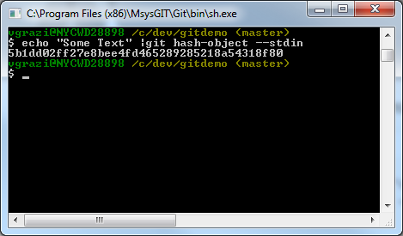
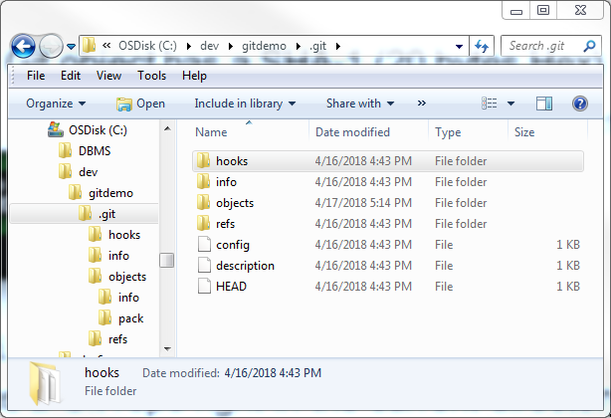
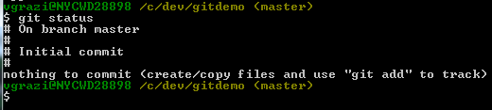
Digging in
Every Git object has a SHA-1 (20 bytes Hex)
echo “Some text” | git hash-object –stdin
git init - creates a Git repo
right in the current directory:
git cat-file -p <sha-1> Displays the object content
git status

Slide 21
Digging in
Every Git object has a SHA-1 (20 bytes Hex)
echo “Some text” | git hash-object –stdin
git init - creates a Git repo
right in the current directory:
git cat-file -p <sha-1> Displays the object content

Slide 22
Digging in
git status

Slide 23
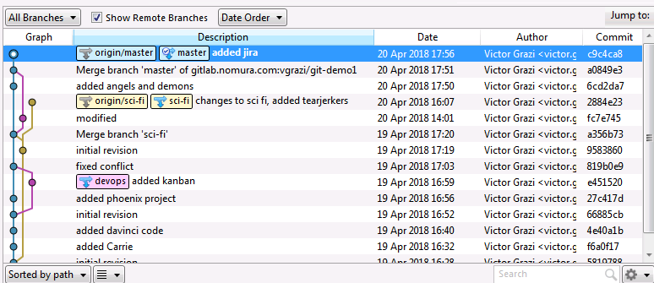
Git –
Notes:
Once you do an init, you can start versioning anything under that directory. No need for a remote

Slide 24



Works every time!

Slide 25
Continuous Integration Timeline
Prehistorically – Developers manually built code and delivered it to a human integrator
every 3 months integrator would manually ”integrate” everyone’s work
a grueling, tortuous process!
1994 – Grady Booch writes Object-Oriented Analysis and Design with Applications
uses the phrase “continuous integration” to explain how "internal releases represent a sort of continuous integration of the system"
1997 – Kent Beck and Ron Jeffries invented Extreme Programming (XP) while on the Chrysler Comprehensive Compensation System project, including continuous integration
1999 – Beck elaborates on continuous integration in his first full book on Extreme programming, emphasizing importance of face-to-face communication
2001 – CruiseControl released - the first CI/Build server
2005 – Linus Torvalds creates Git while developing Linux to address SVN shortfalls
2009 – Martin Fowler publishes his popular blog posting on feature branching https://martinfowler.com/bliki/FeatureBranch.html
2012 – Vincent Driessen introduces Gitflow

Slide 26
Git - What’s a commit?
A commit consists of:
“Blob” objects for each file in that commit
A ”Tree” object pointing to those blobs,
A “Commit” object that points to that tree
$ git cat-file –p 92ec2
tree 1d97b9a335ec
parent 639a1cde8e
author Victor Grazi
committer Victor Grazi

Slide 27
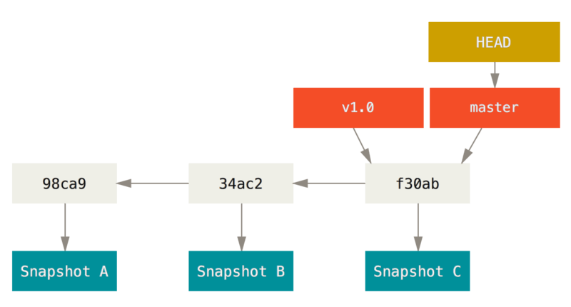
What’s a branch?
Head points to the current branch
A branch is simply a pointer to a commit:
$ git log --oneline --decorate
Notes:
because a branch is just a pointer, it is very cheap to create and destroy.
This should encourage developers to do so often
Give your branches a name that include both your JIRA and a brief description

Slide 28
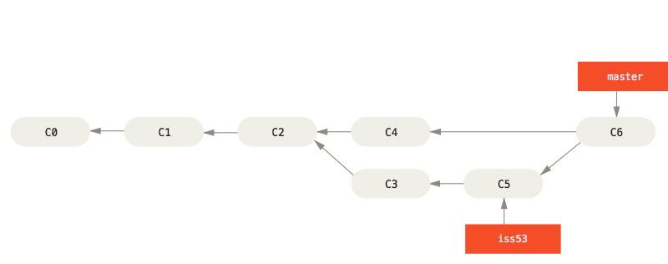
Merging branches creates a new commit
$ git merge --no-ff

Slide 29
Git branch commands
$ git branch -v scifi 93b412c fix javascript issue
* master 7a98805 Merge branch ‘scifi'
testing 782fd34 add f451
Branches without a ‘*' are fully merged and may be deleted safely

Slide 30
Merge
Rebase
’
’
’
m5
v3
v3
m4
m4
v2
v2
Time
m3
m3
v1
v1
m2
m2
m1
m1
master
my-branch
master
my-branch
$ git checkout my-branch
$ git merge master
$ git checkout my-branch
$ git rebase master

Slide 31
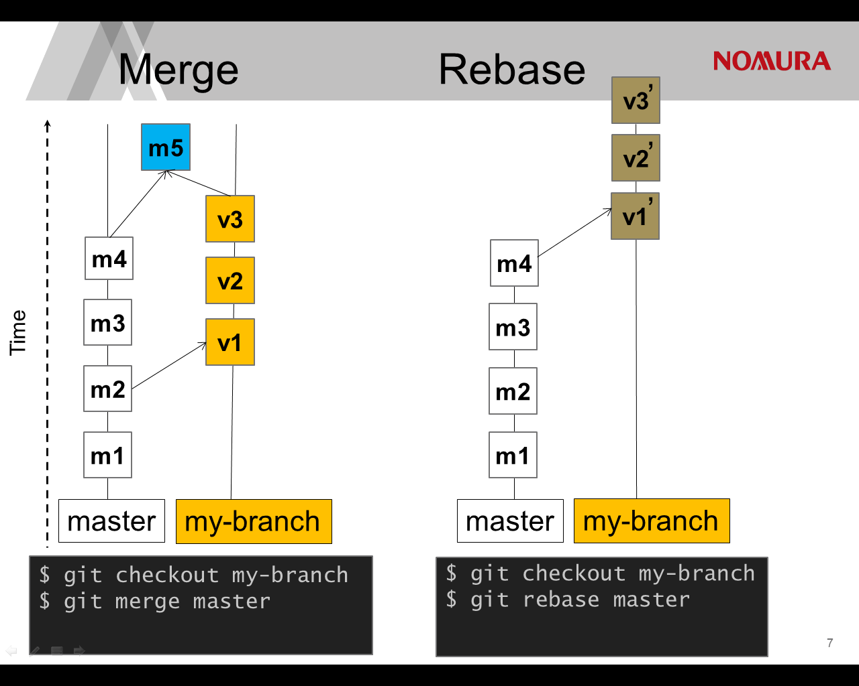

Slide 32
Cherry-pick
’
’
’
Under Construction
v3
m4
v2
Time
m3
v1
m2
m1
master
my-branch
$ git checkout my-branch
$ git rebase master

Slide 33
Why Branch?
You’re building a new application feature
Do some work on a feature
Create a branch for that feature
Do more work on that branch
Stuff happens…. need to work on a critical prod issue
Checkout prod branch
Create a branch for the fix
Test, merge, release
Switch back to the original branch and continue

Slide 34
Why Branch?
Or, you’re working on a feature,
you don’t want to push it to mainline until it is relatively stable,
but you do want to commit frequently.

Slide 35
Requirements of Collaborative Development
“Everyone commits to the mainline every day.” (The fundamental rule of continuous integration)
Resolve code conflicts early
Don’t let different branches generate the same snapshot version
Git is not just a VCS, it is a development tool

Slide 36
Which Branching Strategy? Decision points
Does you current strategy work? If it ain’t broke, don’t fix it!
otherwise…. consider – what’s broken, make small change then look again!
Number of active versions
Team size
Degree of collaboration
Regional distribution
Volatility
Modularization of codebase

Slide 37
Centralized Work (no branches)
master
Create Release Tag 1.0.0
Time
Create Release Tag 1.0.1
Create Release Tag 1.1.0
Jenkins
Notes:
This is a great approach for a large development team that is coming off of SVN, and has not yet become accustomed to the simplicity of Git branching.
It has the following merits
Developers know they have to commit frequently
You never fall behind because you pull very frequently (i.e. before every commit!)
Conflicts are detected early, which is the easiest time for them to be corrected
Developers know that their commits are impacting everyone so it promotes good citizenship
You get continuous integration, there is no confusion about build versions
Downside
Everything is comingled, so it is difficult to review your own feature changes in isolation
There is no feature segregation, so you can’t easily decide which features to include in the next release and which to defer.

Slide 38
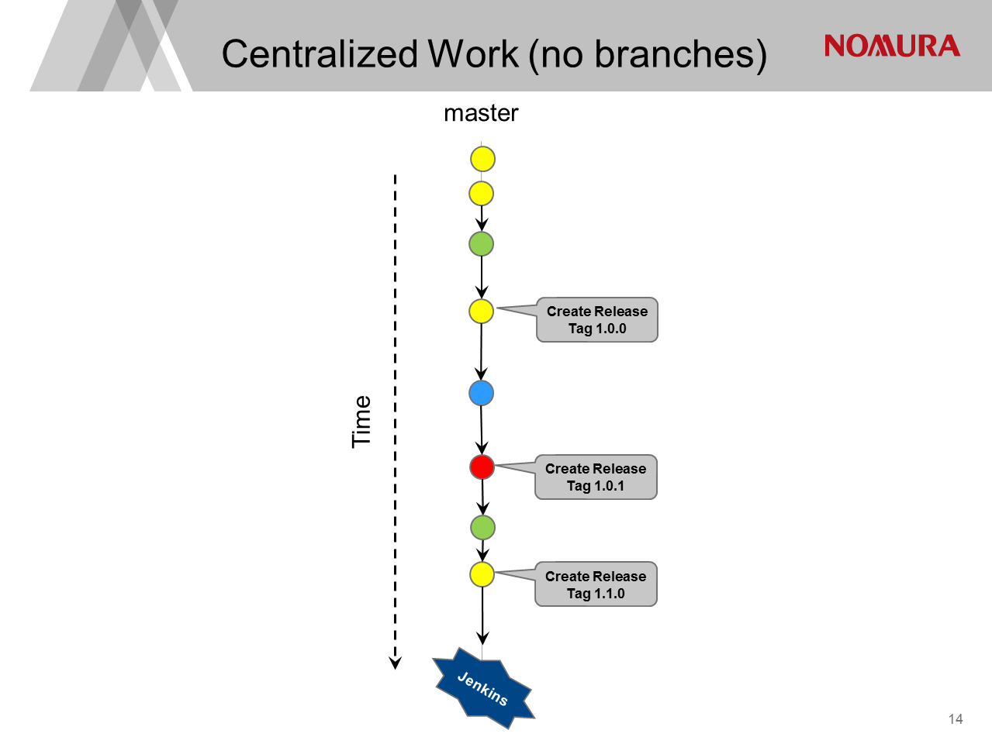
Notes:
This is a great approach for a large development team that is coming off of SVN, and has not yet become accustomed to the simplicity of Git branching.
It has the following merits
Developers know they have to commit frequently
You never fall behind because you pull very frequently (i.e. before every commit!)
Conflicts are detected early, which is the easiest time for them to be corrected
Developers know that their commits are impacting everyone so it promotes good citizenship
You get continuous integration, there is no confusion about build versions
Downside
Everything is comingled, so it is difficult to review your own feature changes in isolation
There is no feature segregation, so you can’t easily decide which features to include in the next release and which to defer.

Slide 39
Merits
Useful for large teams coming off SVN, not yet accustomed to the simplicity of Git branching.
Developers commit frequently
You must pull very frequently (i.e. before every push!) so conflicts are detected early, which is the easiest time for them to be corrected
Master must be stable - developers know that their commits are impacting everyone so it promotes good citizenship
You get continuous integration, there is no confusion about build versions
Downside
Difficult to maintain different versions concurrently
Everything is comingled, difficult to review your feature changes in isolation
No feature segregation, difficult to decide which features to include in release and which to defer.
Centralized Work (no branches)

Slide 40

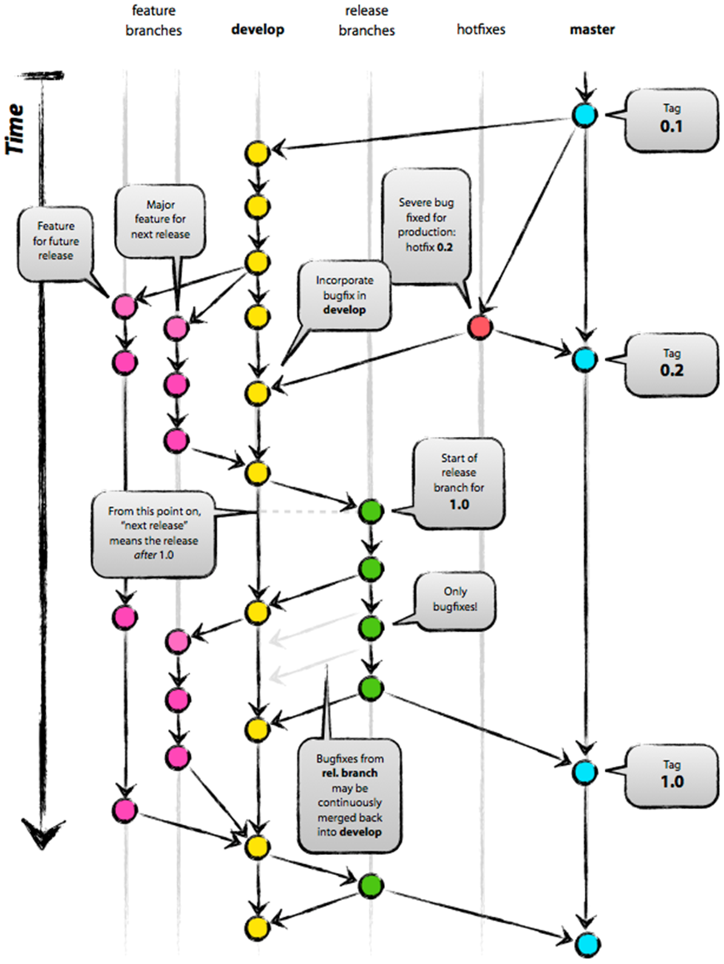
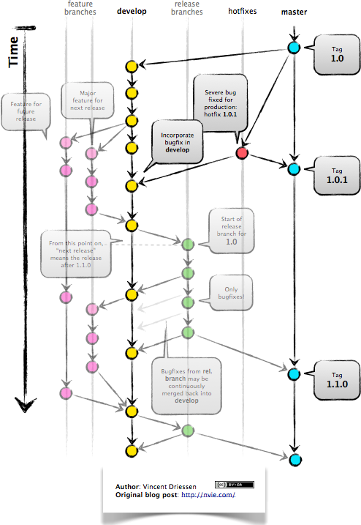
GitFlow - by Vincent Driessen - January 2012
http://nvie.com/posts/a-successful-git-branching-model/
1.0.1
1.1.0
1.1.0

Slide 41
feature
branches
develop
(unstable)
release
branch
master
(stable)
hotfixes
Feature for future release
Major feature for next release
Start of release branch for 1.1.0
Time
Bug fixes from ‘release’ are continuously merged back into ‘develop’
Create Tag 1.1.1
(Patch release)
Bug fixes go directly on ‘release’
Severe bug fixed hotfix 1.1.1
Jenkins
snapshots
Gitflow
Jenkins
releases
40
Notes:
Master tracks the official release history. When you start, branch a develop branch off master
Develop is “unstable”, an integration branch for new features
When a feature is complete, merge it back into the develop branch
When it is time for a release, a release branch is created from develop
UAT testing is performed on the release
Then continue to build, deploy and fix until happiness
Creating and resetting branches are easy!
Challenges with this approach:
Builds aren’t configured to run on feature branches.
Conflicts materialize on the develop branch, and you won’t notice them until you pull and merge the feature.

Slide 42
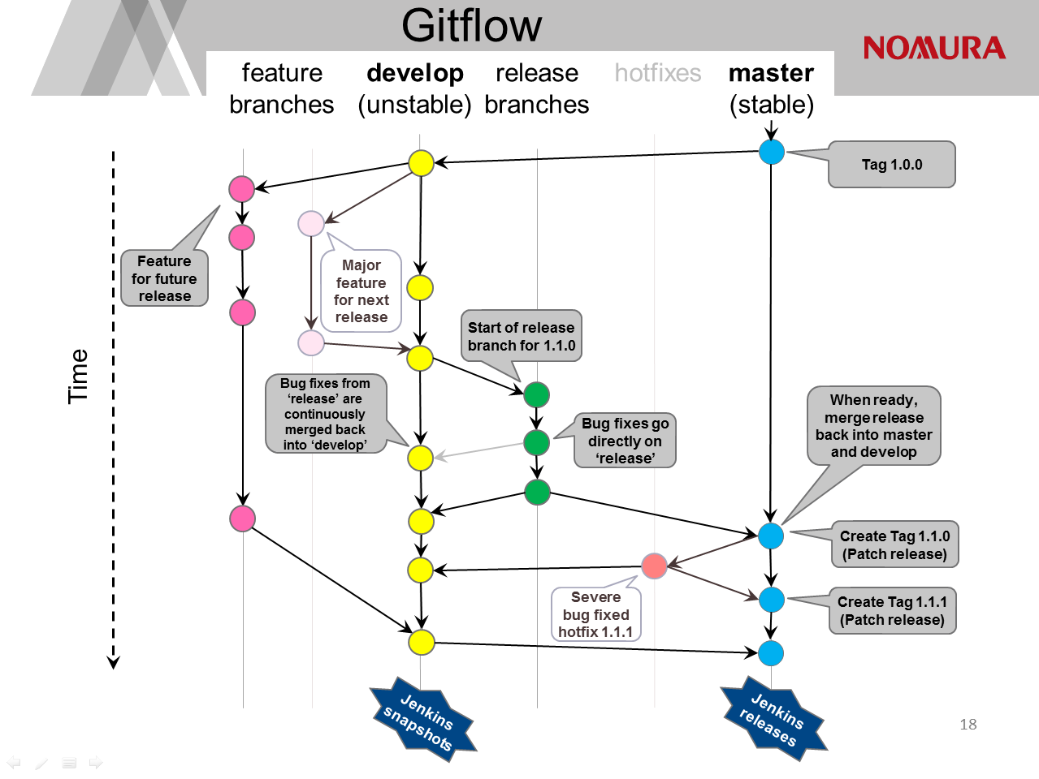
Notes:
Master tracks the official release history. When you start, branch a develop branch off master
Develop is “unstable”, an integration branch for new features
When a feature is complete, merge it back into the develop branch
When it is time for a release, a release branch is created from develop
UAT testing is performed on the release
Then continue to build, deploy and fix until happiness
Creating and resetting branches are easy!
Challenges with this approach:
Builds aren’t configured to run on feature branches.
Conflicts materialize on the develop branch, and you won’t notice them until you pull and merge the feature.

Slide 43
Gitflow
Merits
Features are isolated – easy to manage your own feature changes in isolation
Easy to maintain different versions
Feature segregation, lets you decide which features to include in release.
Downside
Changes maintained on feature branches, hard to do continuous integration
Or you build snapshots off every feature branch, causing ambiguous binaries for a given pom version
Notes:
Master tracks the official release history. When you start, branch a develop branch off master
Develop is “unstable”, an integration branch for new features
When a feature is complete, merge it back into the develop branch
When it is time for a release, a release branch is created from develop
UAT testing is performed on the release
Then continue to build, deploy and fix until happiness
Challenges with this approach:

Slide 44
Summary
Git branching is simple, collaboration is not
If what you’re doing works, stay with it
If not, tweak it, try it, and revise as necessary
Remember the rules:
Merge to master often to minimize conflicts
Integrate often
Keep your mainline “master” stable!
Don’t let different branches generate the same snapshot version

Slide 45
More Information
Git documentation: https://git-scm.com/doc
http://github.com/nvie/gitflow
https://www.atlassian.com/git/tutorials/comparing-workflows
https://martinfowler.com/bliki/FeatureBranch.html

